Slide 1
Computer Networks
By
Lt Col Ishtiaq Kiani
(10 Sep 12 to 12 Jan 13)

Slide 2
PART 2
Physical Layer

Slide 3
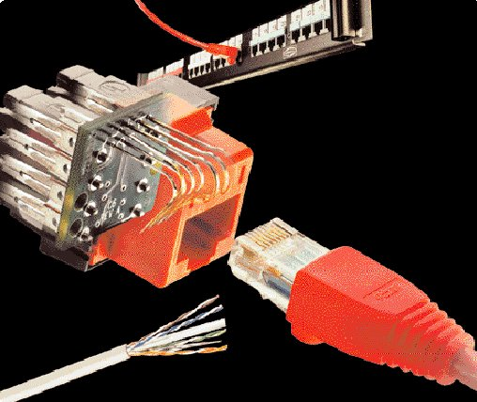
Chapter 7 Transmission Media
Guided Media
Unguided Media - wireless

Slide 4
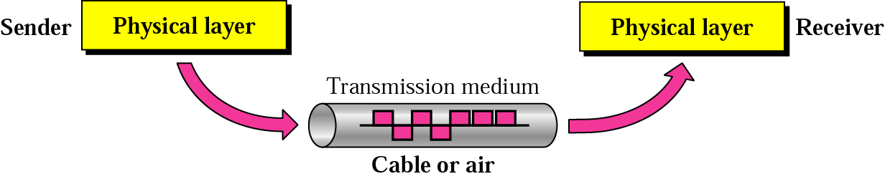
Transmission Media

Slide 5
Transmission Media

Slide 6
Guided Media

Slide 7
Guided Media
Twisted Pair Cable

Slide 8
Guided Media
Effect of noise on Parallel Lines

Slide 9
Guided Media
Effect of noise on Twisted Pair Cable

Slide 10
Guided Media
Unshielded Twisted Pair Cable

Slide 11
Guided Media
Connectors

Slide 12
Guided Media
Shielded Twisted Pair Cable

Slide 13
Guided Media
Coaxial Cable
Category | Impedance | Use
RG-59 | 75 Ω | Cable TV
RG-58 | 50 Ω | Thin Ethernet
RG-11 | 50 Ω | Thick Ethernet

Slide 14

Guided Media
Optical Fiber Cable
Optical fibers use light to send information through the optical medium.
It uses the principal of total internal reflection.
Modulated light transmissions are used to transmit the signal.

Slide 15
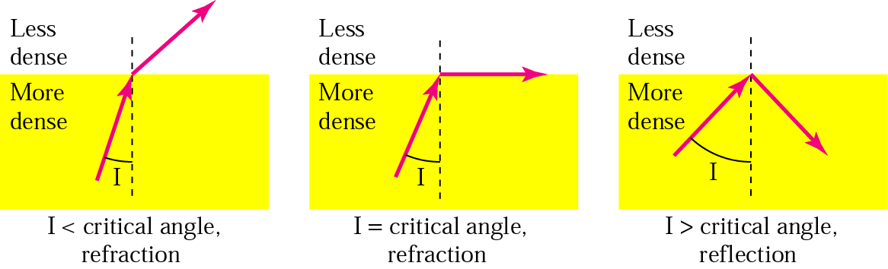
Guided Media
Optical Fiber Cable

Slide 16
Guided Media
Optical Fiber Cable
Light travels through the optical media by the way of total internal reflection.
Modulation scheme used is intensity modulation.
Two types of Fiber media :
Multimode
Singlemode
Multimode Fiber can support less bandwidth than Singlemode Fiber.
Singlemode Fiber has a very small core and carry only one beam of light. It can support Gbps data rates over > 100 Km without using repeaters.

Slide 17
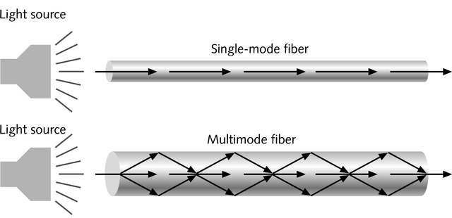
Guided Media
Optical Fiber Cable
Single-mode fiber
Carries light pulses along single path
Uses Laser Light Source
Multimode fiber
Many pulses of light generated by LED travel at different angles

Slide 18
Guided Media
Optical Fiber Cable
The bandwidth of the fiber is limited due to the dispersion effect.
Distance Bandwidth product of a fiber is almost a constant.
Fiber optic cables consist of multiple fibers packed inside protective covering.
62.5/125 µm (850/1310 nm) multimode fiber
50/125 µm (850/1310 nm) multimode fiber
10 µm (1310 nm) single-mode fiber

Slide 19
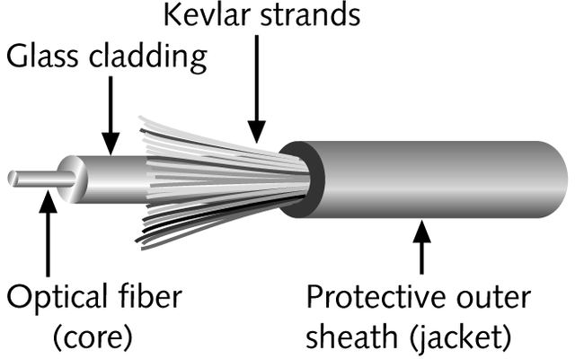
Guided Media
Optical Fiber Cable
Contains one or several glass fibers at its core
Surrounding the fibers is a layer called cladding

Slide 20
Guided Media
Optical Fiber Cable
FO Cable may have 1 to over 1000 fibers

Slide 21
Guided Media
Optical Fiber Cable
Advantages
Disadvantages
Higher Bandwidth
Less Signal Attenuation
Immunity to electromagnetic interference
Resistance to corrosive materials
Light Weight
Greater Immunity to tapping
Installation and maintenance
Unidirectional light propagation
Cost

Slide 22
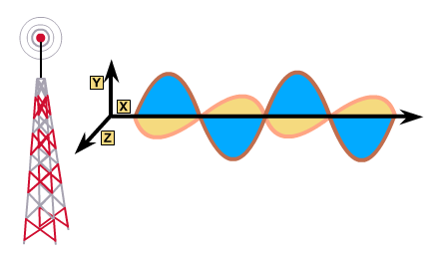
Un – Guided Media
Wireless
Very useful in difficult terrain where cable laying is not possible.
Provides mobility to communication nodes.
Right of way and cable laying costs can be reduced.
Susceptible to rain, atmospheric variations and Objects in transmission path.

Slide 23
Un – Guided Media
Wireless
Indoor : 10 – 50m : BlueTooth, WLAN
Short range Outdoor : 50 – 200m: WLAN
Mid Range Outdoor : 200m – 5 Km : GSM, CDMA, WLAN Point-to-Point, Wi-Max
Long Range Outdoor : 5 Km – 100 Km : Microwave Point-to-Point
Long Distance Communication : Across Continents : Satellite Communication

Slide 24
Un – Guided Media
Wireless
Band | Range | Propagation | Application
VLF | 3–30 KHz | Ground | Long-range radio navigation
LF | 30–300 KHz | Ground | Radio beacons and navigational locators
MF | 300 KHz–3 MHz | Sky | AM radio
HF | 3–30 MHz | Sky | Citizens band (CB), ship/aircraft communication
VHF | 30–300 MHz | Sky and line-of-sight | VHF TV, FM radio
UHF | 300 MHz–3 GHz | Line-of-sight | UHF TV, cellular phones, paging, satellite
SHF | 3–30 GHz | Line-of-sight | Satellite communication
EHF | 30–300 GHz | Line-of-sight | Long-range radio navigation

Slide 25
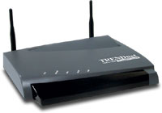

Un – Guided Media
Wireless LAN
PC
Access Point
Internet
Router
Switch
PC
Access Point

Slide 26
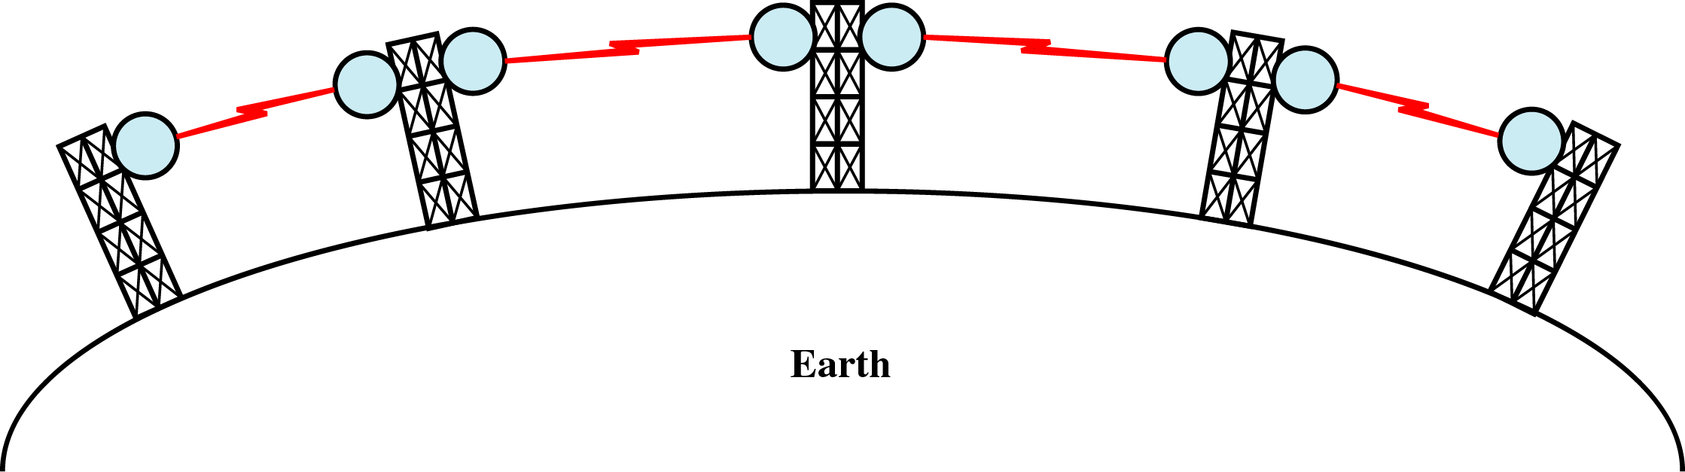
Un – Guided Media
Microwave
Microwaves do not follow the curvature of earth
Line-of-Sight transmission
Height allows the signal to travel farther
Two frequencies for two way communication
Repeater is used to increase the distance Hop-by-Hop

Slide 27
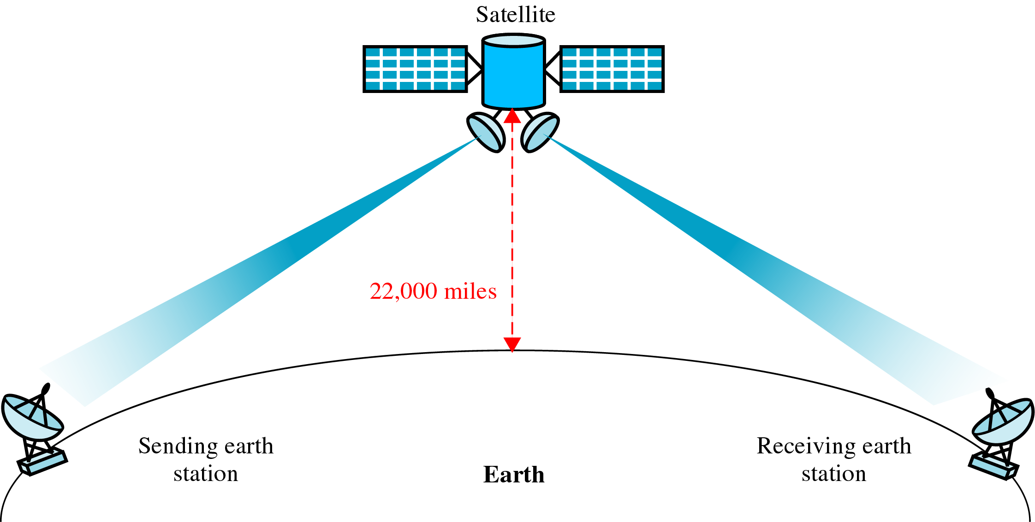
Un – Guided Media
Microwave

